Slide 1
Problem Analysis paradigms
System analysis and design
5th sem
II nd Internal Assignment
-By Divyansh Patel
IT-2K19-15

Slide 2
1. Purpose
This Topic introduces several paradigms for locating, pinpointing, and identifying a problem or an opportunity, including decomposition, factoring, synthesis, and generate and test. These paradigms can also be applied to problem solving.
2. Inputs .
These paradigms serve as the philosophical basis for numerous tools, techniques, and methodologies. Significant links will be noted in context.

Slide 3
3.Concepts
There are several paradigms for locating, pinpointing, and identifying a problem or an opportunity. These paradigms serve as the philosophical basis for numerous problem-solving tools, techniques, and methodologies.
Decomposition:
top-down, goal-oriented approach that is used when the problem is too complex or too abstract to study directly.
the idea is to divide (or decompose) the problem into logically consistent, more manageable sub-problems, and then to attack the sub-problems
the decomposition approach divides a large, abstract problem into several small, concrete sub-problems, each with clear goals or specific tasks to perform

Slide 4
Weakness:
The primary weakness of decomposition is that it can be difficult to track the interrelationships between the sub-problems
independently solving a number of sub-problems can be time consuming.
Determining acceptable criteria for decomposing the main problem can also
be a difficult task.

Slide 5
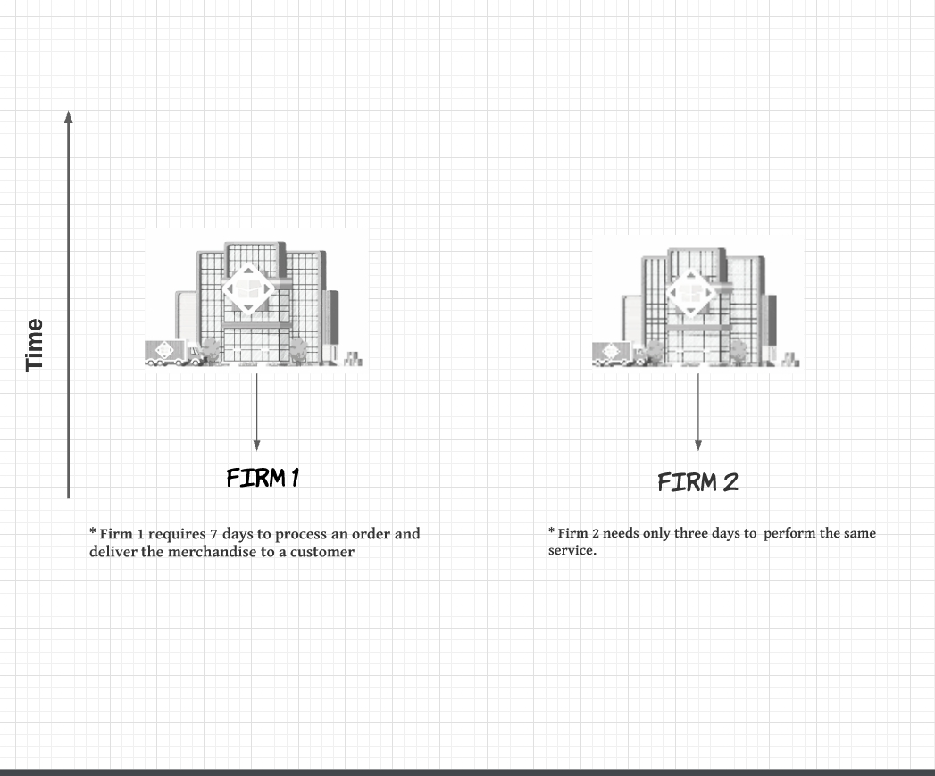

Slide 6
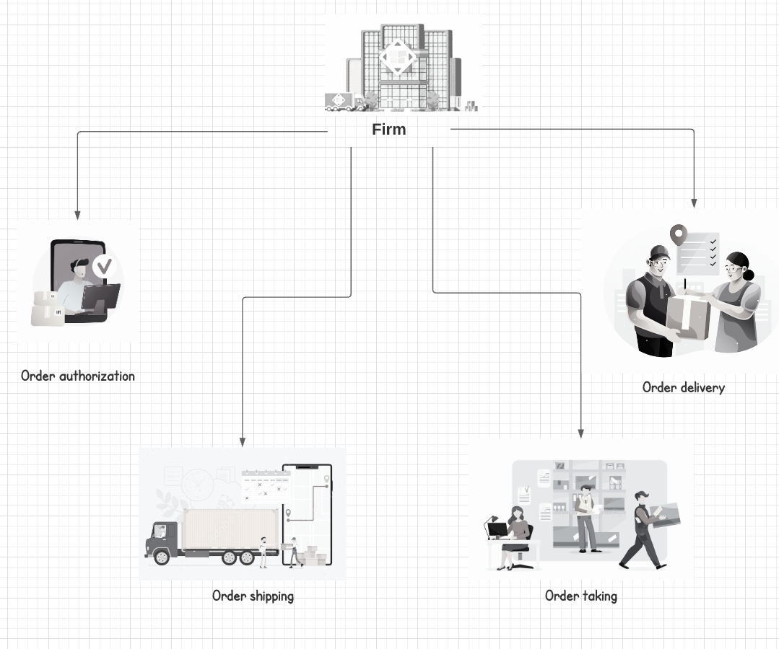

Slide 7
2. Factoring
The essential idea of factoring is to merge several small, isolated, overlapping, or related problems to form a meta-problem
reformulating the problem by identifying those sub-problems that share similar characteristics, and then grouping the related sub-problems.
Focusing on the meta-problems is likely to be more efficient than attempting to independently analyze the sub-problems.

Slide 8
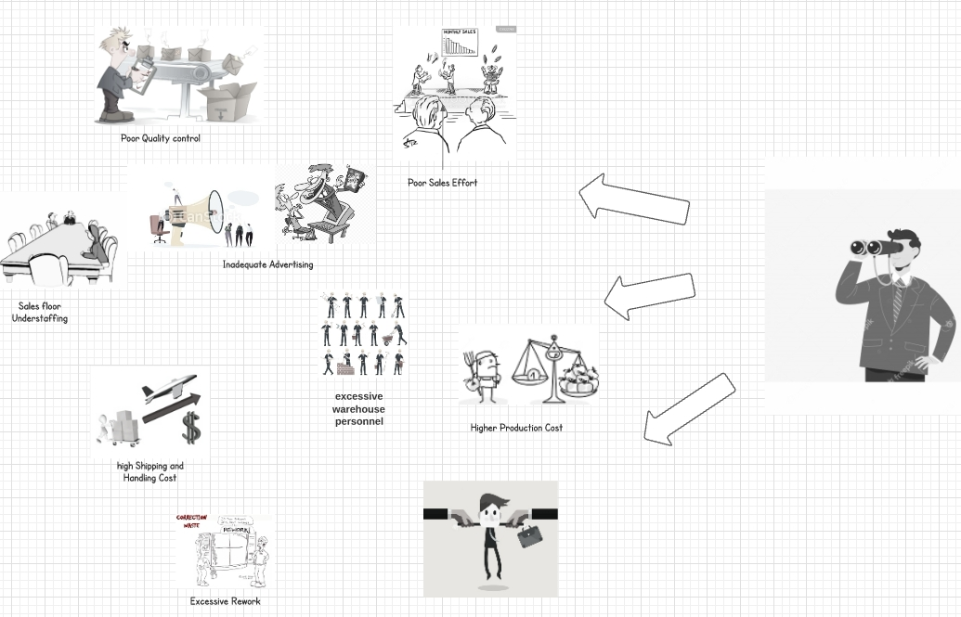

Slide 9
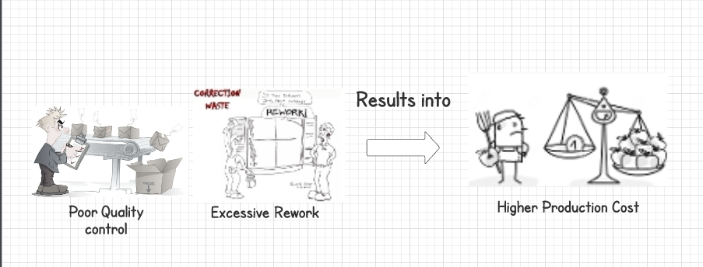

Slide 10
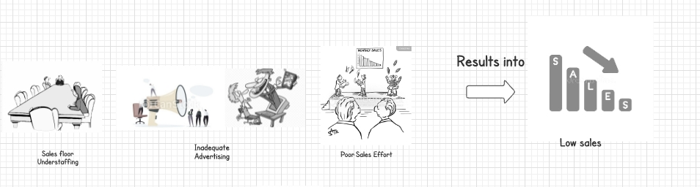

Slide 11
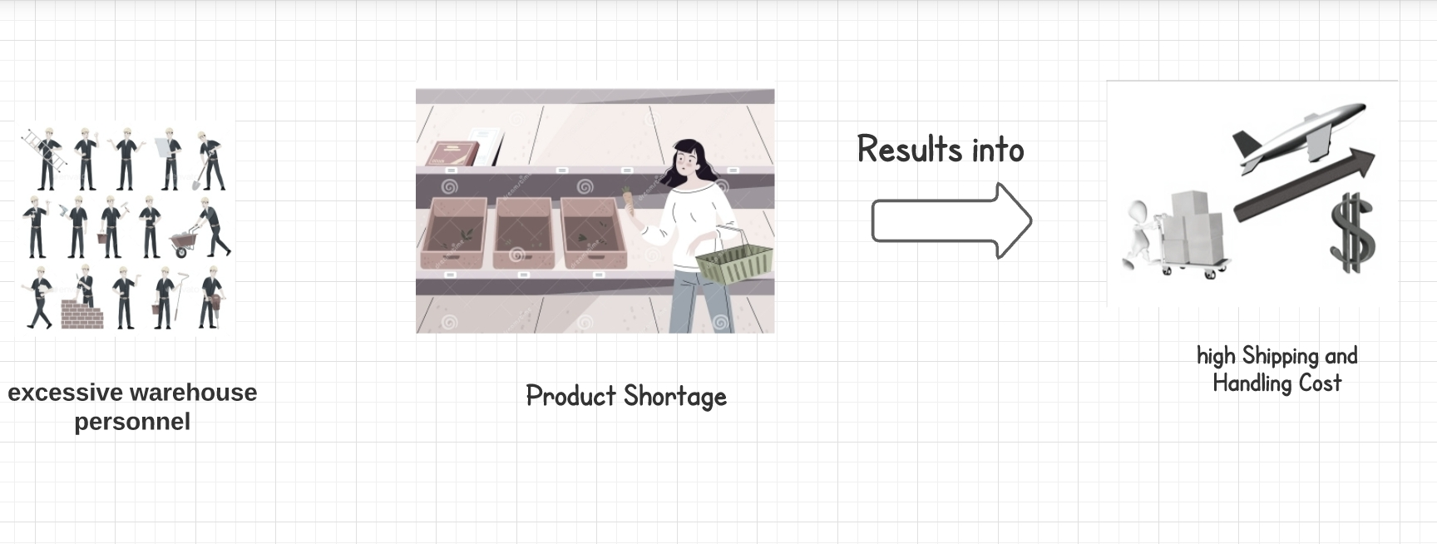

Slide 12
3. Synthesis
is an evolutionary paradigm
the core problem is well-defined and well-structured and the sub-problems are simple add-on functions that use the core as a base
starts with a major or influential user’s viewpoint and expands by incorporating other users’ perspectives until all relevant viewpoints are included

Slide 13
Weakness :
The major concern with synthesis is correctly identifying the core problem
comprehensive testing is difficult because of the evolutionary nature of the paradigm

Slide 14
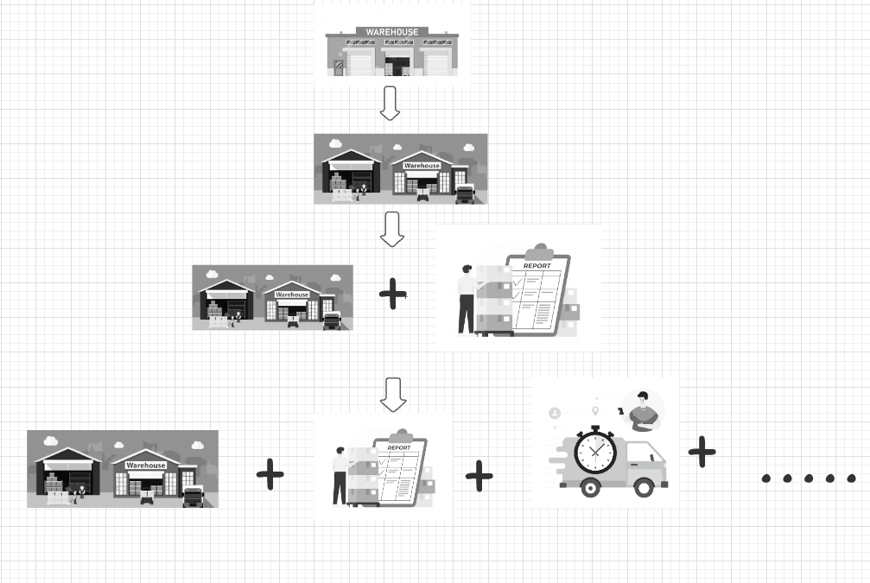

Slide 15
4. Generate and test
is a hierarchical, test-oriented paradigm used in expert systems to define a solution that meets certain criteria or constraints
The technique starts at the top of a hierarchy with the main problem and continues down the hierarchy through the sub-problems, conducting tests of the appropriate criteria and constraints at each level until the bottom is reached and no more testing is necessary
the most important strength of the generate-and-test paradigm is its focus on real world constraints.

Slide 16
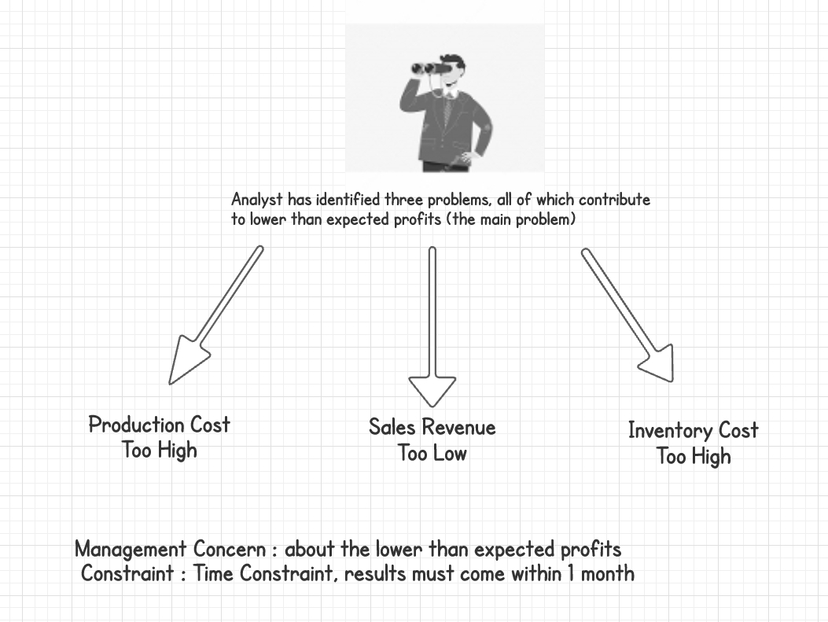

Slide 17
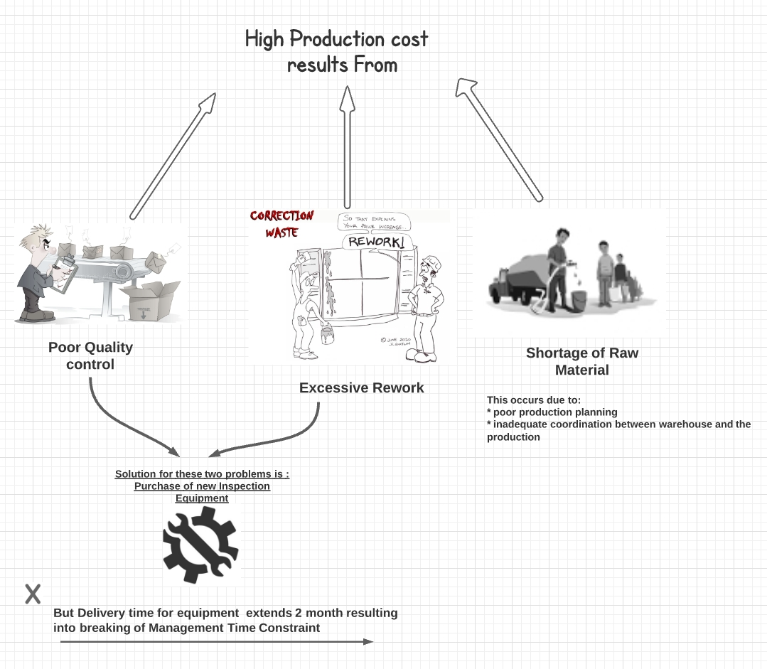

Slide 18
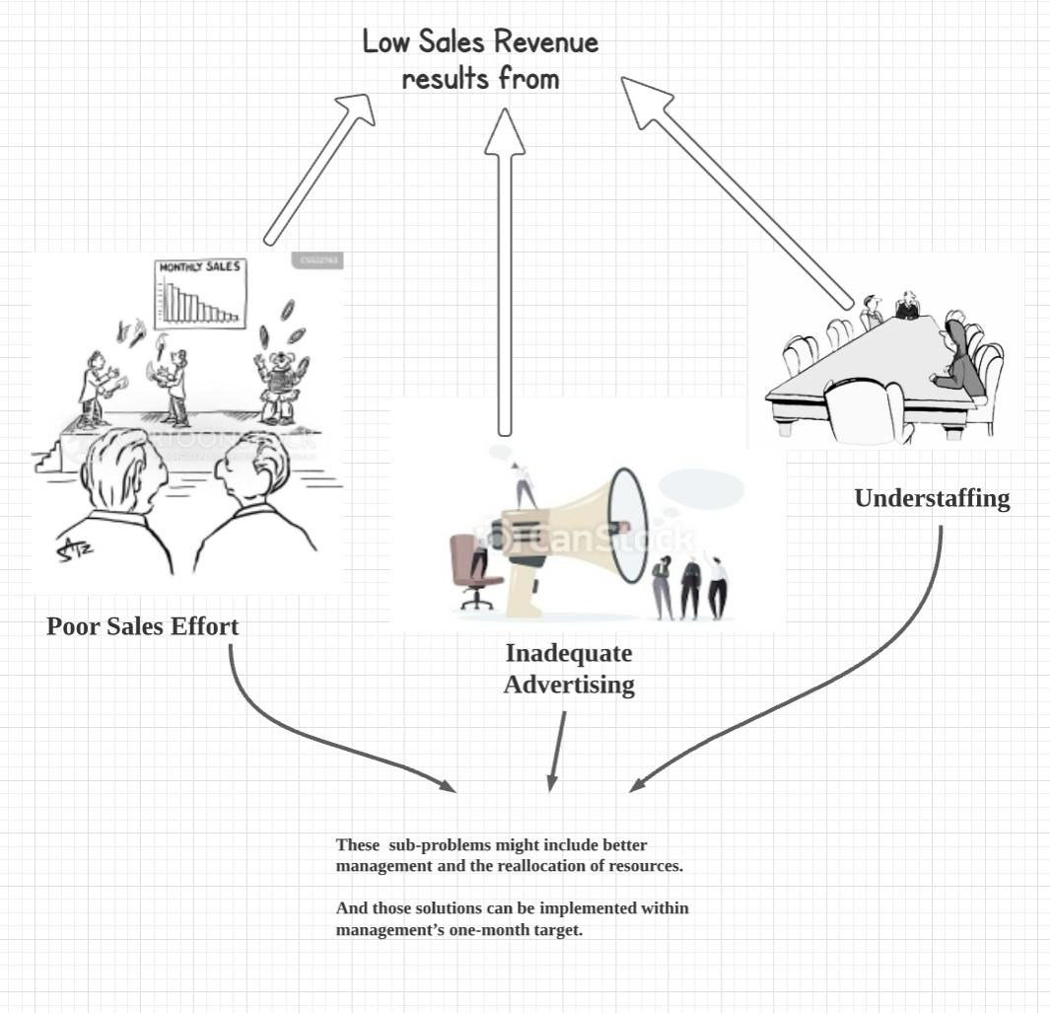

Slide 19
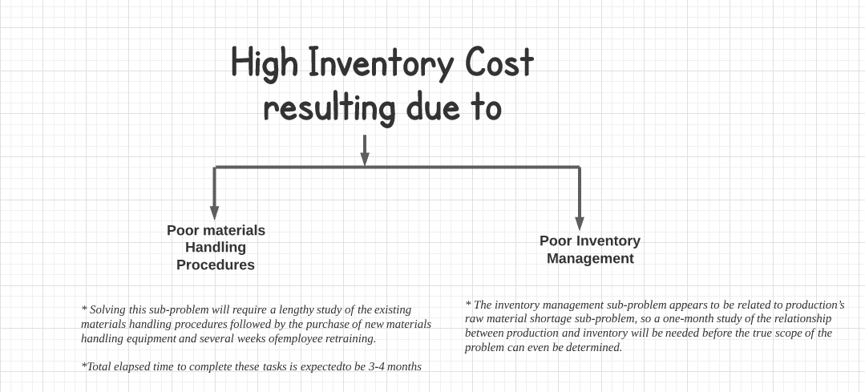

Slide 20
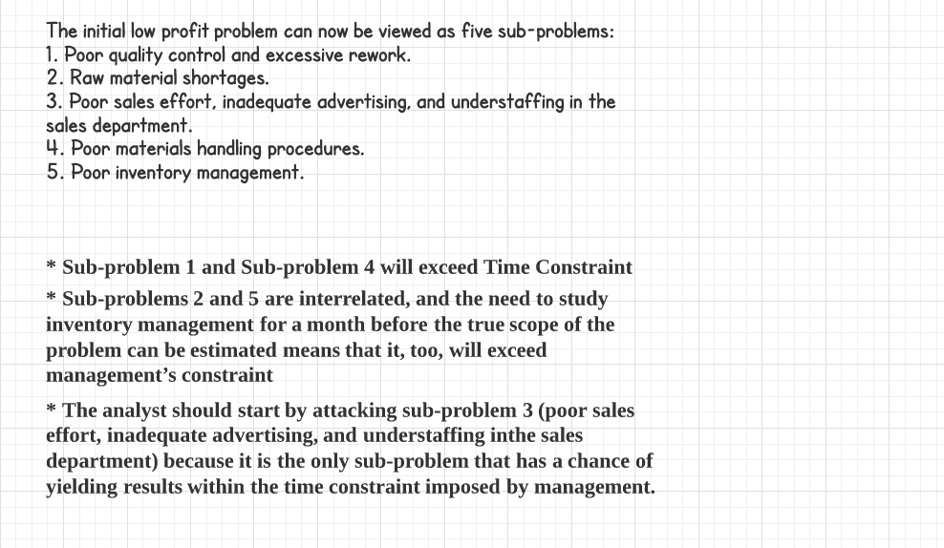

Slide 21
4. References
1. Awad, E. W., Building Expert Systems: Principles, Procedures, and Applications,
West, Minneapolis/St. Paul, MN, 1996.
2. Buchanan, B. G., and Shortliffe, E. H., Rule-Based Expert Systems: The MYCIN
Experiments of the Standard Heuristic Programming Project, Addison-Wesley,
Reading, MA, 1984.
3. Connor, D., Information Systems Specification & Design Road Map, Prentice-Hall,
Englewood Cliffs, NJ, 1985.
4. Hayes-Roth, F., Waterman, D. A., and Lenat, D. B., Building Expert Systems,
Addison-Wesley, Reading, MA, 1983.
5. Holsapple, C. W., and Whinston, A. B., Business Expert Systems, Irwin,
Homewood, IL, 1987.
6. Liebowitz, J., and De Salvo, D. A., Structured Expert Systems: Domain, Design,
and Development, Prentice-Hall, Englewood Cliffs, NJ, 1989.
7. Waterman, D. A., A Guide to Expert Systems, Addison-Wesley, Reading, MA,
1986.
8. Zahedi F., Intelligent Systems for Business: Expert Systems with Neural Networks,
Wadsworth, Belmont, CA, 1993

